Slide 1
Data mining: Clustering How to let data tell you what sub-groups you have

Slide 2
Warning
Clustering methods, and much of expression methods, like to use matrices, which is different from the tidyverse way of thinking about plots.
So, there we will walk quite a lot between base R and tidyverse R…

Slide 3
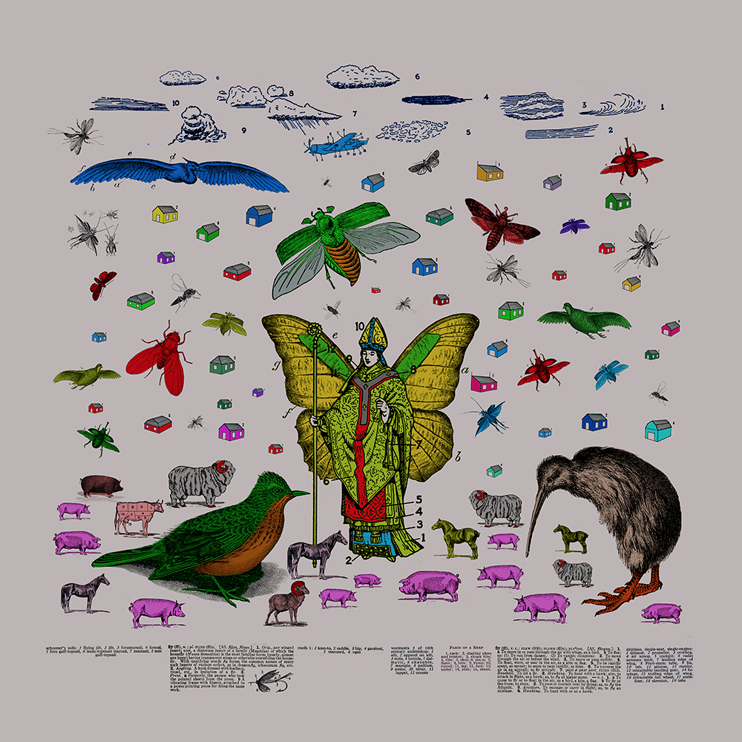
Subgrouping and classification: Not in any way unique for genomics – classification and reduction methods basically defines natural science
In "The Analytical Language of John Wilkins," Borges describes 'a certain Chinese Encyclopedia,' the Celestial Emporium of Benevolent Knowledge, in which it is written that animals are divided into:
those that belong to the Emperor,
embalmed ones,
those that are trained,
suckling pigs,
mermaids,
fabulous ones,
stray dogs,
those included in the present classification,
those that tremble as if they were mad,
innumerable ones,
those drawn with a very fine camelhair brush,
others,
those that have just broken a flower vase,
those that from a long way off look like flies.
Are the entries here mutually exclusive?

Slide 4
Up to now we have been looking at pairs of vectors, and plotted those against each other (2D plots)
But say that we have a table with gene expression for 20000 genes in patients 1-10. We want to know which ones that correlate well
How can we plot all of that in a smart way?
11-dimensional plots - not a great idea.

Slide 5
Using numbers to say how similar vectors are
Since we cannot plot all these vectors, we use numbers instead ,saying how similar the vectors are
For instance, we could have done
> cor(genes_patient1, genes_patient2)
[1] 0.7101906
> cor(genes_patient1, genes_3)
[1] -0.003013128
> cor(genes_patient2, genes_patient)
[1] -0.005726535
# etc…
These are _almost_ like distances between the vectors. What is wrong with that analogy?

Slide 6
Real distances
Distance is the opposite of a similarity score in the sense that similar objects are close to each other
In math, a real distance measurement requires
Distance between a and b is always positive, or 0 of a==b
It is symmetric, so a → b is the same as b → a
Distances satisfies triangle inequality (not going into that, too mathy)
cor() gives a similarity score which is can be negative, so it is not an intuitive distance. Also, high correlation means that objects are similar, so the direction is wrong.

Slide 7
What do you mean, close?
We need to define how we measure distance, or similarity
Many ways of doing it, with different advantages
We looked at cor before
Let us start out with the classic, Euclidian, measurement (known from high school), which is dealing with real-world distances

Slide 8
Euclidian, in two dimensions
If I have two points on the board, the distance D between them is the distance measured by a ruler ☺
We can calculate this instead by knowing the coordinates – we always get a triangle, which takes us back to high-school geometry –
c²=a²+b²
Or…

Slide 9
Each dot is a gene: what is the distance between genes?
Expression
in tissue A
Expression in tissue B

Slide 10
Three dimensional euclician distance
Imagine that we have 3 tissue (x, y, z)
measurements for two genes
This just expands the math with an extra term
Two dimensions
Three dimensions
And so forth. It is possible to add as many dimensions as you want,
but it is hard to visualize after 3
If we have four tissues, it would be a four-dimensional space

Slide 11
Euclian distance in R - example
Say that we have three tissue measurements for four genes
This can be described by four vectors of size 3 in a matrix

Slide 12
tissue_matrix<- matrix(c( 10, 10, 10, 10.1, 10.1, 10.1, 13, 13, 13, 8, 15, 7 ),
nrow=4, byrow=T, dimnames=list(
c("gene1", "gene2", "gene3", "gene4"),
c("adipose", "brain", "cortex")))
tissue_matrix
adipose brain cortex
gene1 10.0 10.0 10.0
gene2 10.1 10.1 10.1
gene3 13.0 13.0 13.0
gene4 8.0 15.0 7.0

Slide 13
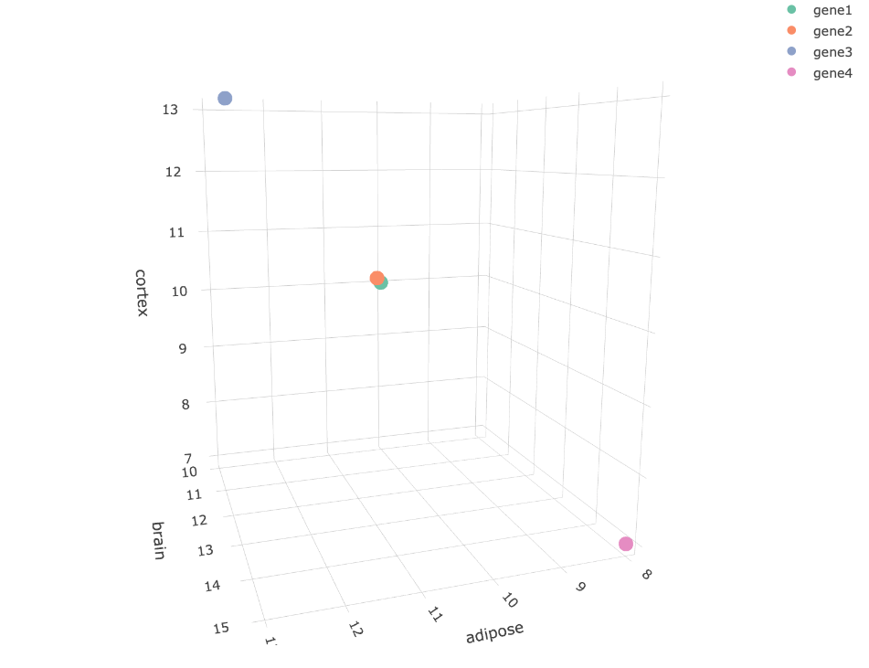
We can view these 4 vectors as coordinates in a three-dimensional space
(because, we have three tissues)
For once, a 3d chart
actually makes sense
This is actually rotatable
Let me know if you want
to see the R code

Slide 14
It is intuitive that genes 1 and 2 are very similar and genes 3 and 4 are different from any other genes
another way of viewing this is that genes 1 and 2 are very close in 3d space
Can we quantify it? Yes, by Eucluidian distance

Slide 15
dist() calculates the pairwise euclidian distance between
all rows in matrices. Which is exactly what we want:
tissue_matrix
adipose brain cortex
gene1 10.0 10.0 10.0
gene2 10.1 10.1 10.1
gene3 13.0 13.0 13.0
gene4 8.0 15.0 7.0
dist(tissue_matrix)
gene1 gene2 gene3
gene2 0.1732051
gene3 5.1961524 5.0229473
gene4 6.1644140 6.1668468 8.0622577

Slide 16
tissue_matrix
adipose brain cortex
gene1 10.0 10.0 10.0
gene2 10.1 10.1 10.1
gene3 13.0 13.0 13.0
gene4 8.0 15.0 7.0
dist(tissue_matrix)
gene1 gene2 gene3
gene2 0.1732051
gene3 5.1961524 5.0229473
gene4 6.1644140 6.1668468 8.0622577

Slide 17
We can also plot the gene expression as a line plot – so each gene becomes a line rather than a dot:
tissue_matrix
adipose brain cortex
gene1 10.0 10.0 10.0
gene2 10.1 10.1 10.1
gene3 13.0 13.0 13.0
gene4 8.0 15.0 7.0
as_tibble(tissue_matrix) %>% mutate(gene.id=row.names(tissue_matrix)) %>% gather(key="tissue", value="value", -gene.id)%>%
ggplot(aes(y=value, x=tissue, col=gene.id, group=gene.id))+ geom_line()+theme_bw()
The same pattern comes up again, but in another way

Slide 18
So, the distance measurement is useful to
quantify these relationships
dist(tissue_matrix)
gene1 gene2 gene3
gene2 0.1732051
gene3 5.1961524 5.0229473
gene4 6.1644140 6.1668468 8.0622577
Wehn we get more than 4 tissues, we cannot visualize the points anymore, but the line plot wil work

Slide 19
Other distance measures – just an orientation
Manhattan distance – walk in blocks instead of diagonals
Maximal – the largest difference at any pair of points
Identity, or edit distance – only makes sense if you compare words or sequences
1- R² (Pearson) – based on correlation

Slide 20
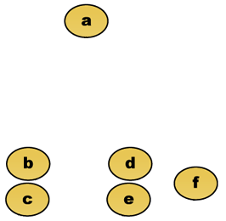
An example with 6 patients, with distances to each other How do we cluster these?

Slide 21
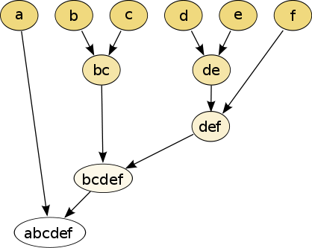
Centroid-based clustering
Fundamental idea is to create a “center” that defines sub-groups
Example: k-means
Hierarchical clustering
We build a tree that connects all the nodes, where similar nodes will be in sub-trees

Slide 22
K means
K-means is a method that is not hierarchical
It instead makes the “k” most “stable” clusters from the data, where we select “k”
It uses a random component – this means your results are not always the same. This is due to that finding the optimal solution is very expensive
So, it pays to run your script many times

Slide 23
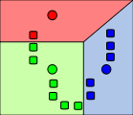
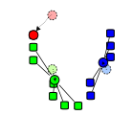
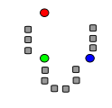
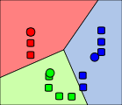
1 ) Randomly assign k
start nodes. We will call
these the “means”
Here k is selected to be 3
2 ) Assign clusters,
based on closest mean
3) Update means:
For each cluster, figure
out the “centroid” – the center
of the current cluster. This will
be the new “mean”
4) Redo 2-3 until clusters do not change anymore
In action example:
https://www.youtube.com/watch?v=BVFG7fd1H30

Slide 24
Let’s try k-means on some patient data
Do part I: k-means part of the clustering tutorial

Slide 25
Issues with k-means
How do we select a good k?
Some mathematical ways of doing it (% explained variance, and more – not part of this course)
Biological checks – do these clusters make any sense at all
Practicality – you often want ~4-10 clusters, not 100
Random component
Slow for large datasets (there are faster variants)

Slide 26
Hierarchical clustering
Take the two closest nodes
Merge them to a new node
Redo until you have one node left

Slide 27
Back to business: building trees/dendrograms by clustering stuff
So, we have selected a way to say how close A and B and C are to each other.
How to make a “tree”?

Slide 28
Agglomerative hierarchical clustering
We start with every gene in a separate cluster
We keep merging the most similar pairs of data points/clusters until we have one big cluster left
Merged points will make a new point – if we merge two points, these points will be “removed”
Continue until we only have a single point left

Slide 29
To make a tree we need
1) Distances, all vs all – the output of is a ew matrix with all-vs-all distances of the columns of my_matrix:
my_distances<- dist(my_matrix)
2) A method to construct and plot the hierarchical tree
my_tree<-hclust(my_distances)
plot(my_tree)

Slide 30
hclust() or agnes()
R can cluster hierarchically with the hclust method (comes with R), or the more advanced agnes() method, in the cluster package
hclust requires a distance matrix as those we made before
agnes can make its own from the data – either way goes
Can be as simple as saying
my_tree <- hclust(my_distance_matrix)
plot(my_tree)

Slide 31
Example from before, but as tree
tissue_matrix
adipose brain cortex
gene1 10.0 10.0 10.0
gene2 10.1 10.1 10.1
gene3 13.0 13.0 13.0
gene4 8.0 15.0 7.0
my_distances<- dist(tissue_matrix)
my_tree<-hclust(my_distances)
plot(my_tree)

Slide 32
Agglomeration
How do we merge points? What is the distance to the “child” nodes?
How can we compare two merged points?
Three examples:
Single, complete and average linkage

Slide 33
Single linkage
The distance between two merged points is the smallest of all the pair-wise distances, counting all the original data points inside each merged point

Slide 34
Complete linkage
The distance between two merged points is the LARGEST of all the pair-wise distances, counting all the original data points inside each merged point

Slide 35
Average linkage
The distance between two merged points is the MEAN of all the pair-wise distances, counting all the original data points inside each merged point

Slide 36
Lets try making trees:
Do part II, Hierarchical clustering part of the tutorial

Slide 37
Heatmaps
Heatmaps is a popular way of visualizing gene expression, but can be used for a lot of things
It uses two concepts:
A “false color plot”, showing genes as rows and time as columns, where the color will indicate the expression
Hierarchical clustering, which puts
genes with similar expression patterns close to one another
Time points which are “close” in terms of expression

Slide 38
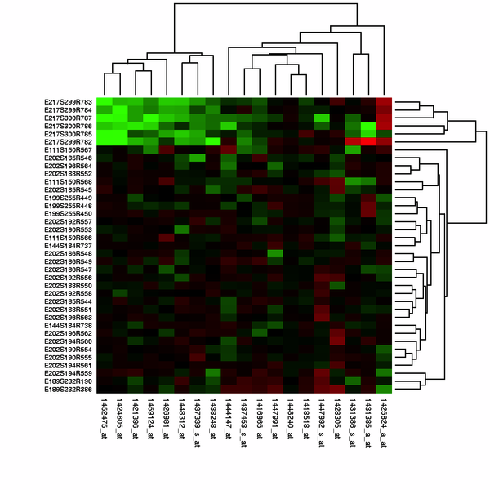
A typical heatmap
Green=low expression
Red= high expression
Black= medium
Historically, this was done to mimic the colors on microarrays
genes
Time, or treatment

Slide 39
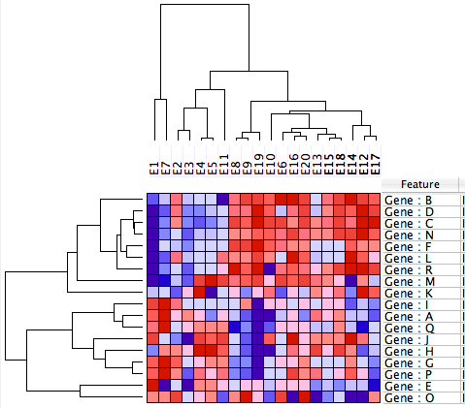
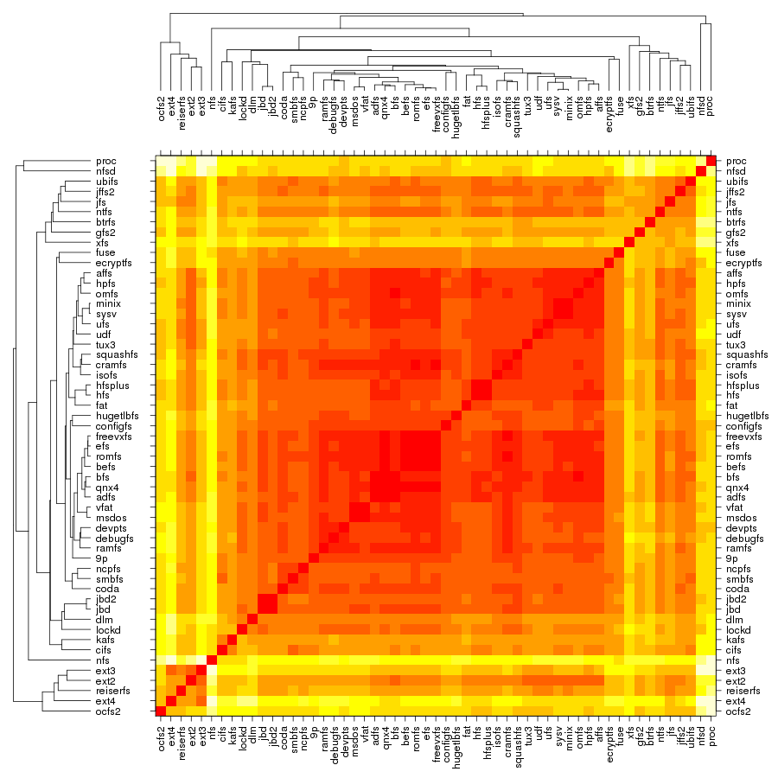
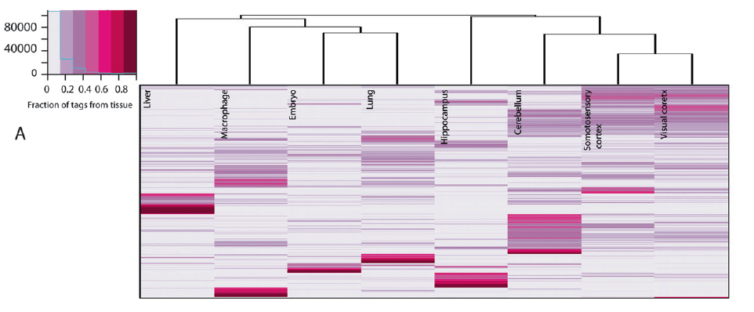
This is a red-green color scheme – very classical, due to that microarrays used to have these two colors
Also VERY non-optimal in terms of human readability!
10% of males cannot see the difference between red and green!
Better color schemes shown below:
Blue-white-red
“Heat” colors
White-pink

Slide 40
Heatmaps in R
Three different ways – all work fine:
heatmap() # basic, in-built
heatmap.2()
# in package gplots: similar, but better
pheatmap()
# much prettier, in package pheatmap. Can also add extra ‘cofactors’ as colored rows or columns – more in exercise.
They work in the same way but has different options
geom_tile in ggplot2 can also be used together with a smooth gradient – although hard to get the trees in (see e.g. https://goo.gl/uhRNSO). pheatmap is often a better choice

Slide 41
Some interesting options (there are many more):
heatmap(x, distfun = dist, hclustfun = hclust, col=heat)
Heatmap needs to do both a distance calculation and a clustering.
This defaults to
dist() for distances – which by default is Euclidian
hclust() for clustering – which by default is “complete” merging
col needs to be given a set of colors, like rainbow(10) or heat(10). heat() is the default in vanilla heatmaps
This MAY be what you want, but likely not!

Slide 42
# making up some data
> test = matrix(rnorm(200), 20, 10)
> test[1:10, seq(1, 10, 2)] = test[1:10, seq(1, 10, 2)] + 3
> test[11:20, seq(2, 10, 2)] = test[11:20, seq(2, 10, 2)] + 2
> test[15:20, seq(2, 10, 2)] = test[15:20, seq(2, 10, 2)] + 4
> colnames(test) = paste("Test", 1:10, sep = "")
> rownames(test) = paste("Gene", 1:20, sep = "")
> head(test)
Test1 Test2 Test3 Test4 Test5 Test6 Test7 Test8 Test9
Gene1 2.124986 0.07204449 4.598088 0.13706725 3.446507 0.23456636 1.261806 0.78531881 3.295152
Gene2 2.337333 -1.84722206 2.538659 -1.10586680 2.526218 0.14089354 3.301463 0.01891520 2.369294
Gene3 2.718509 1.06618374 3.138857 1.13464246 3.130131 -0.02280634 1.113332 -0.24854980 4.135247
Gene4 1.900019 0.25678535 1.411845 -2.92000628 2.883490 1.14154216 4.579748 -1.08219000 3.278055
Gene5 2.572145 -0.39352228 2.973321 0.05949788 2.332919 2.41586584 2.072589 0.71037660 1.997821
Gene6 2.654353 0.78715319 1.910087 -0.69274223 2.058266 0.54981091 1.743460 -0.03095658 3.500439
Test10
Gene1 -0.4302813
Gene2 0.5841553
Gene3 0.3219629
Gene4 -1.5217066
Gene5 -0.4349312
Gene6 0.2676397

Slide 43
Plotting default heatmaps with the different functions using the data we made using three different heat map methods – all using default settings for respective methods.
> heatmap(test)
> heatmap.2(test)
> pheatmap(test)

Slide 44
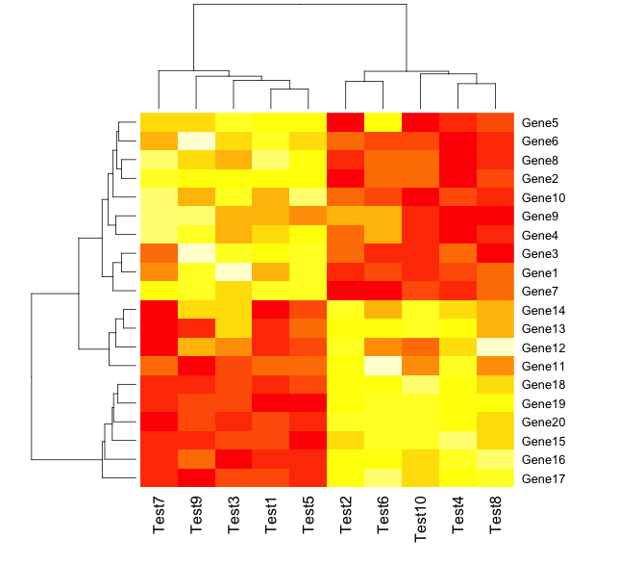
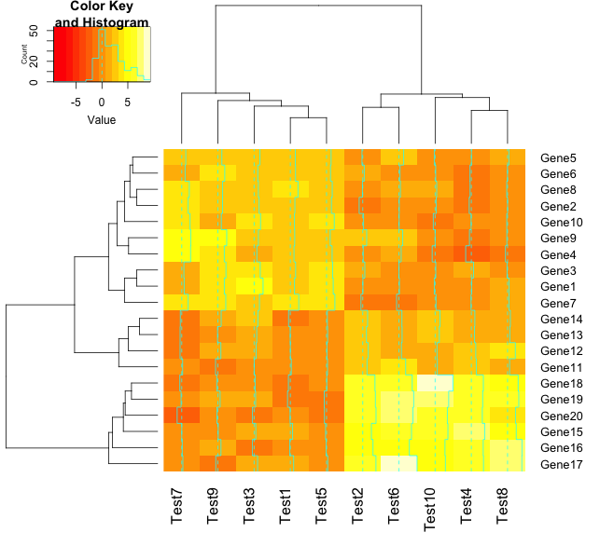
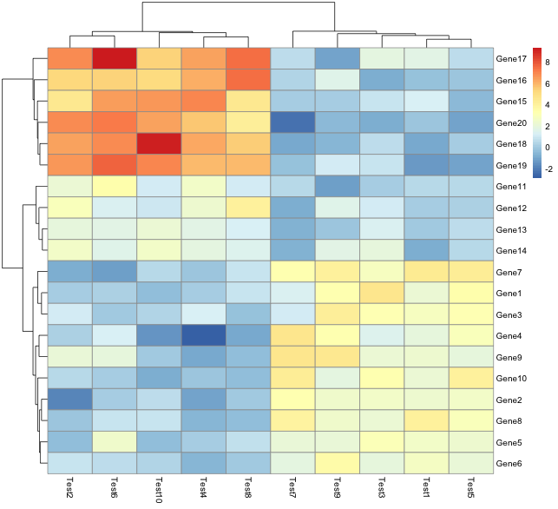
heatmap(test)
heatmap.2(test)
pheatmap (test)

Slide 45
Do the part II: Heat maps in the tutorial .
We will use pheatmap only (which requires a installation of the pheatmap package)

Slide 46
Issues with hierarchical clustering and heatmaps
Hugely dependent on distance and clustering method
Easily over-interpreted, especially with heat maps
Very sensitive to what initial clusters that are made
Best done together with PCA analysis (next-next lecture), which are complementary – next lecture!
Is meant as a help to simplify and understand complex data, not a final result…

